Slide 1
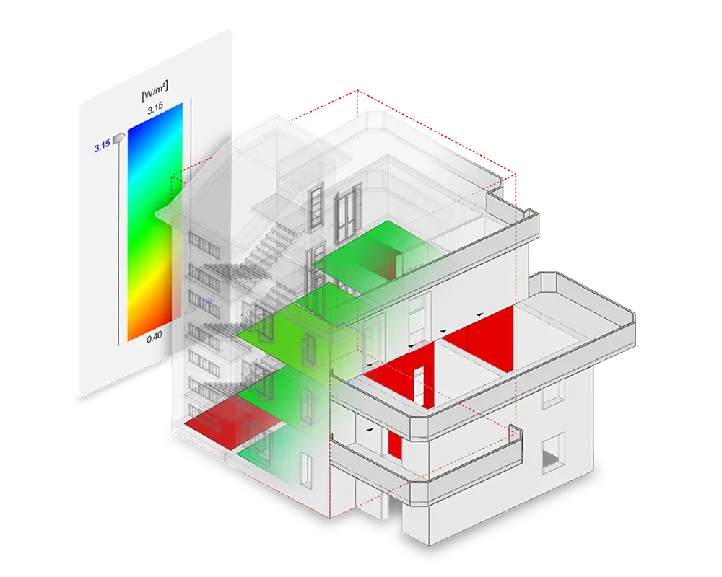
Georgia Undergraduate Research Conference (GURC) 2024
VIP-SMUR
Optimizing Building Energy Consumption: Game Based Approach to Teaching Surrogate Modeling
TEAM: Anubha Mahajan, Jessica Hernandez, Hang Xu, Joseph Mathew Aerathu, Jiayi Li, Han-Syun Shih, Kiana-Karla Layam, Sharmista Debnath, Shivam Patel (Guided by Prof. Patrick Kastner)
‹#›
Notes:
[Introduction] "Good [morning/afternoon], everyone. Today, I’m excited to introduce VIP-SMUR's Energy Predictor, an innovative approach leveraging surrogate models to enhance energy simulations for urban regeneration. Let’s dive into the background and current solutions for this transformative tool.

Slide 2
Background
1
Vision & Mission of VIP-SMUR @ GT
Surrogate Models for Urban Regeneration:
Machine learning-based surrogate models to accelerate environmental simulations
Real-time feedback for urban decision-makers
Notes:
[Background] To start, let’s discuss the role of surrogate models in urban regeneration. Traditional energy simulations help architects and planners assess the environmental impacts of different design choices. By comparing the carbon footprint, energy usage, and other sustainability metrics, they can make informed decisions about building design and operation. These simulations are essential in optimizing energy efficiency, enhancing occupant comfort, and identifying areas for improvement in high-energy-use systems.

Slide 3
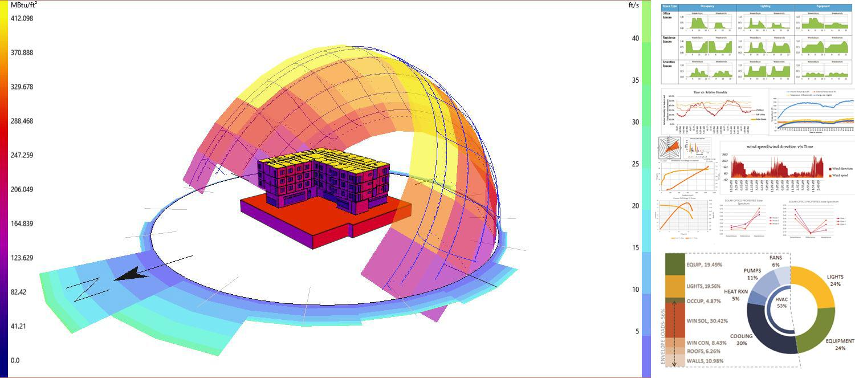
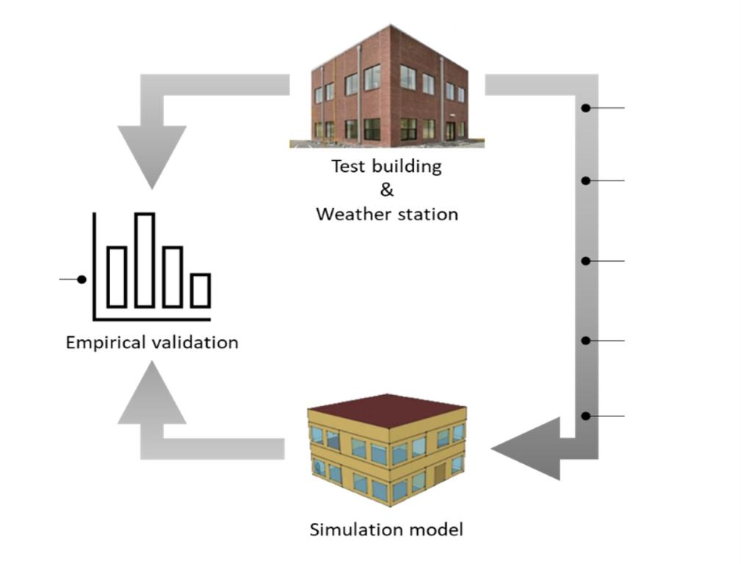
Introduction
2
Problem Statement - GHG Emissions in Built Environment , research question
Energy simulations enable architects to
Access and compare carbon footprint and energy usage of different design options
Support informed decision-making to enhance thermal comfort for occupants
Develop renewable energy solutions to optimize daily building operations
Notes:
Moreover, energy simulations support the integration of renewable energy solutions, helping reduce peak energy demands and meet stringent sustainability and regulatory standards. The challenge, however, is that conventional simulation methods, while accurate, are time-consuming and computationally intensive. This is where machine learning-based surrogate models come in. These models offer real-time feedback, allowing urban decision-makers to act quickly and effectively in designing more sustainable cities.

Slide 4
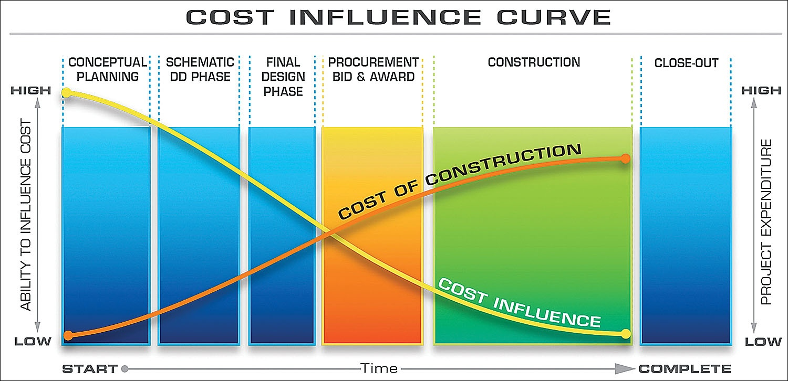
Why to gamify energy modeling?
3
Research Findings & Motivation
Energy simulation tools are vital but often used too late for maximum impact
Harvard study: game-based tools cut office EUI by 22–31% and are preferred by students
Gamification enables efficient, early-stage design choices
Rewards/penalties guide practical, budget-conscious decisions
Notes:
"Energy simulation is crucial in design, especially for meeting standards like LEED, but traditional methods often happen too late in the process, reducing their impact. A Harvard study found that a game-based approach to energy simulation led to office designs with 22–31% lower energy use intensity, with students preferring it for its interactive, early-stage feedback.
Gamifying the process allows designers to explore options and make efficient choices from the concept stage. Adding rewards and penalties also simulates budget constraints, guiding practical decisions over simply selecting the most advanced, often costly, options."
Energy simulation tools are increasingly essential in the design process, driven by green building standards like LEED, but traditional methods often delay their use to later stages, reducing their impact.
A Harvard University study demonstrated that a game-based approach to energy simulation led to office building designs with 22–31% lower energy use intensity (EUI) compared to base models, with students favoring this approach over conventional methods.
A gamified or simplified approach enables early-stage energy-efficient decision-making, allowing designers to test multiple iterations, compare options, and make informed choices from the concept stage.
Integrating reward/penalty scenarios can emulate early-stage project budgets and restrictions, guiding users to make practical choices rather than defaulting to the most advanced options for each parameter.

Slide 5
Current Solutions
4
Energy Modeling, Non-ML Methods
Traditional physics-based energy simulation workflow:
1. Data
Collection
2. Simulation Setup
3. Run
Simulation
4. Analyzing Results
5. Design Iterations
Building geometry, building characteristics, building usage, climate/weather data
Select simulation software + tools, define simulation scope, input parameters
Adjust inputs, time consuming
Validating accuracy, visualizing results, observe EUI + Demand patterns
Identify energy saving solutions
Notes:
[Current Solutions] Now, let’s look at the limitations of current workflows. Traditional energy simulation follows a multi-step process:
Data Collection – where we gather details on building geometry, usage, characteristics, and climate data.
Simulation Setup – selecting software, defining the scope, and inputting parameters.
Running Simulations – a step that is typically time-intensive.
Analyzing Results – validating data accuracy, visualizing energy use patterns, and identifying areas for potential energy savings.
Design Iterations – a repetitive process to refine energy-saving solutions.
While these workflows produce accurate results, they’re not scalable for large, complex urban projects due to their computational demands. To overcome these barriers, the industry is shifting toward machine learning and data-driven models. These models offer scalable, real-time insights, making them far more adaptable and efficient for urban regeneration.

Slide 6
Our Solution
5
Machine Learning Model for Energy Estimation - Type of Model, Advantages, Technical Metrics
Data-driven energy simulation workflow:
Developed a statistical machine learning framework to evaluate the impact of ten predictor variables on heating load (HL) and cooling load (CL) in commercial buildings, using data from the ComStock dataset and OpenStudio simulation files verified by
.tsv
Cross
Validation
Gamify
.osm
data
Data Cleaning
Data Encoding
Model
Selection
Energy
Prediction
.csv
Feature Engineering
Model
Interpretation
Step 1: Reading/Merging
Step 2: Preprocessing
Step 3: Optimisation
Step 4: Application
Notes:
We spent almost a year on extracting the data
Data encoding transforms the data into a format that the model can easily read and interpret
Feature engineering is a crucial step in the data preprocessing process for machine learning, as it directly impacts the model's performance and accuracy. In feature engineering, the goal is to create meaningful features from raw data that can improve the model's ability to learn patterns

Slide 7
Our Solution
6
Machine Learning Model for Energy Estimation - Type of Model, Advantages, Technical Metrics
Model Selection
Linear Regression
Best for numerical data, especially when there’s a linear relationship between the target variable and features.
Decision Tree
Suitable for both classification and regression, and works with numerical and categorical data.
Random Forest
Useful for both classification and regression tasks, ideal for large datasets and handling high-dimensional data.
Gradient Boosting (including XGBoost, LightGBM, etc.)
Suitable for classification and regression tasks, effective for complex, non-linear data.
← preferred
Notes:
Compared traditional linear regression with a state-of-the-art, nonlinear approach based on decision tree algorithms to enhance the accuracy of energy load analysis
Given the characteristics of the data distribution, multiple linear regression may not be the most suitable approach. Therefore, we opted for tree-based regression models, which are likely to capture complex, non-linear relationships more effectively.

Slide 8
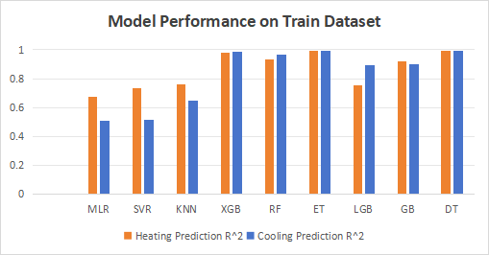
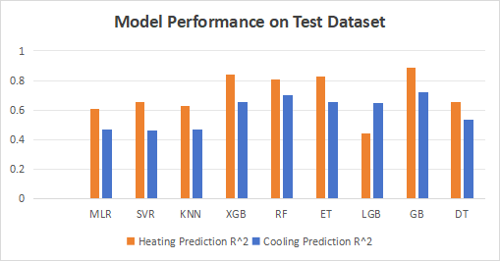
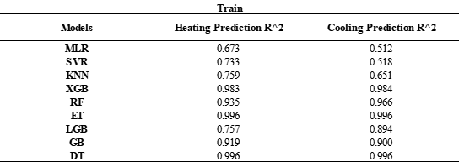
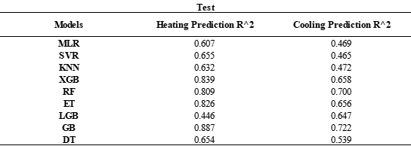
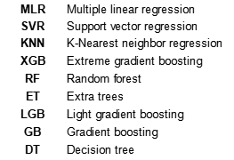
Our Solution
7
Machine Learning Model for Energy Estimation - Type of Model, Advantages, Technical Metrics

Slide 9
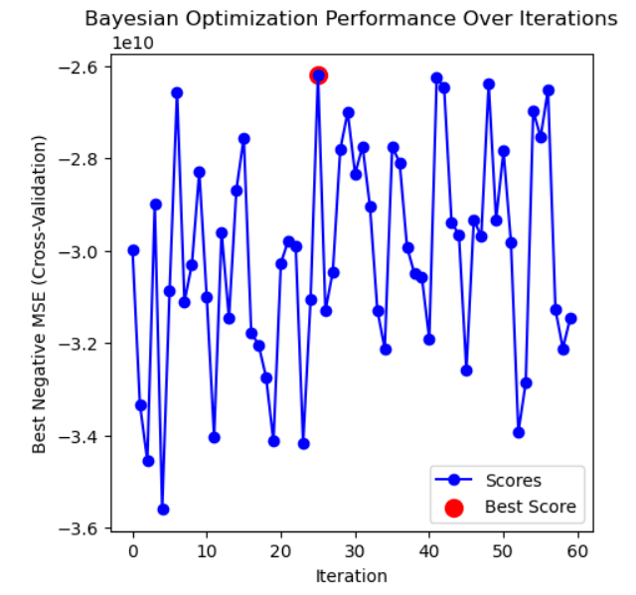
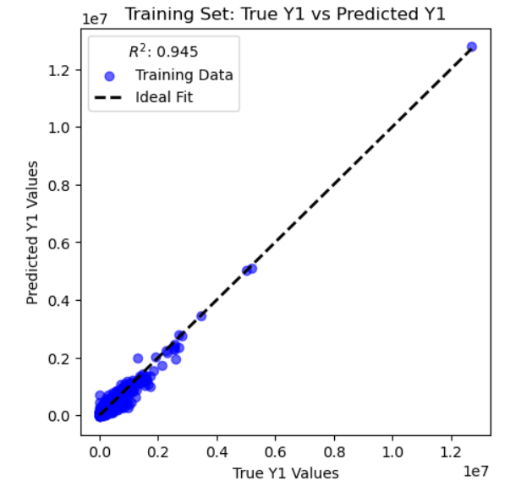
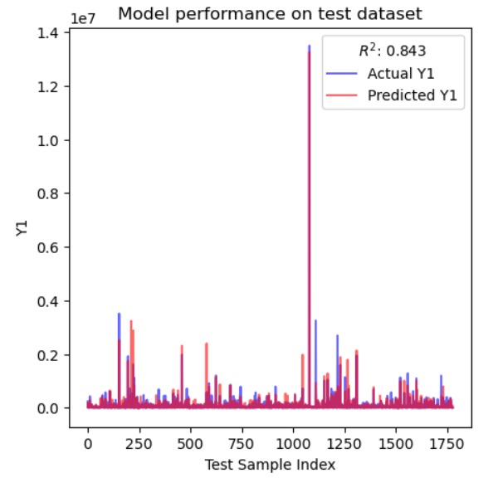
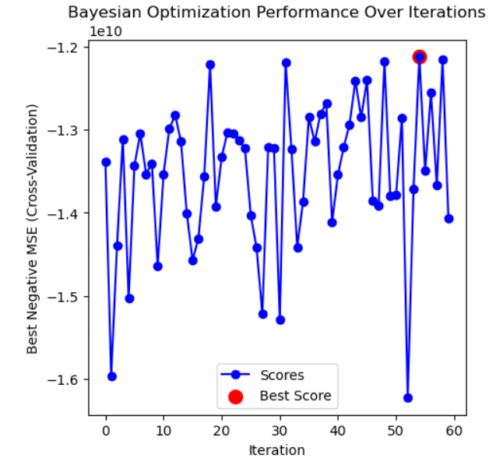
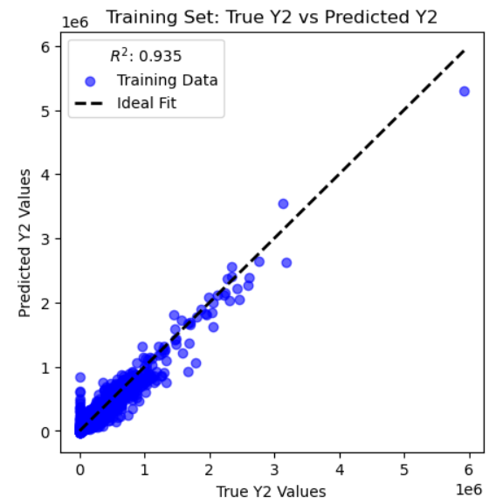
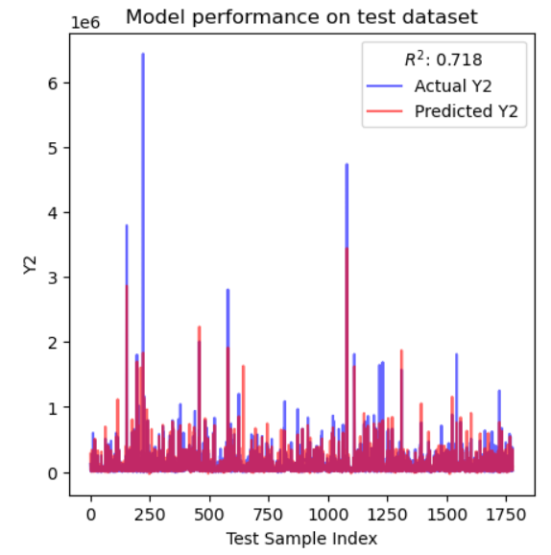
Our Solution
8
Machine Learning Model for Energy Estimation - Type of Model, Advantages, Technical Metrics
Fine-tuned GB model for HL prediction
Best Parameters:
{'learning_rate': 0.076, 'max_depth': 3, 'min_samples_leaf': 1, 'min_samples_split': 6, 'n_estimators': 406, 'subsample': 0.88}
R²: 0.919 → 0.945 on train data
Fine-tuned GB model for CL prediction
Best Parameters:
{'learning_rate': 0.04, 'max_depth': 4, 'min_samples_leaf': 4, 'min_samples_split': 9, 'n_estimators': 302, 'subsample': 0.90}
R²: 0.900 → 0.935 on train data
Notes:
Fine-tuning is the process of taking a pre-trained model (usually on a large dataset) and adapting it to perform well on a more specific dataset
We used both grid search and Bayesian optimization to find the optimal hyperparameters for the HL and CL prediction models. Both models fit the training data well, achieving an R-squared value close to 0.95. However, the HL prediction model outperforms the CL model on the test dataset, a result that aligns with findings from similar studies. This outcome suggests that the selected features may have a stronger predictive relevance for heating demand than for cooling demand
Additional accuracy

Slide 10
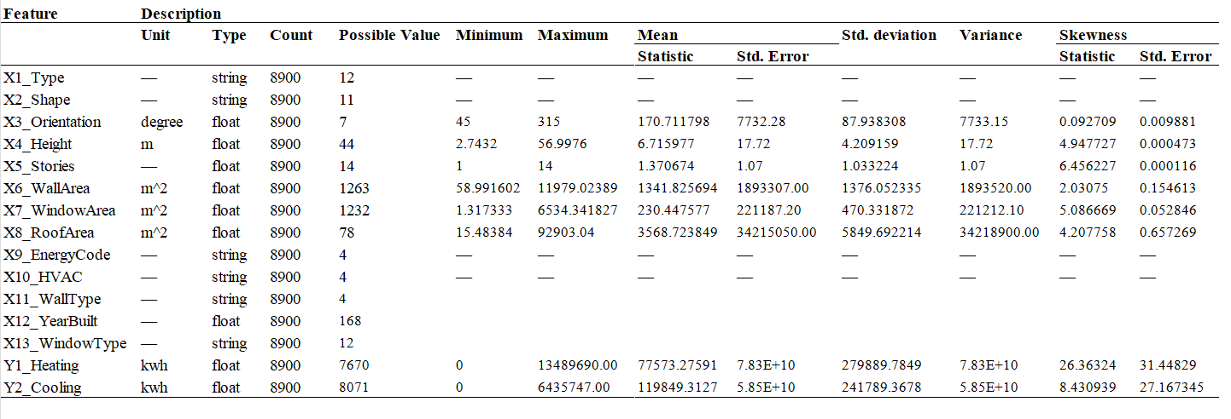
Our Solution
6
Updated datasets with 3 more features
Notes:
Compared traditional linear regression with a state-of-the-art, nonlinear approach based on decision tree algorithms to enhance the accuracy of energy load analysis
Given the characteristics of the data distribution, multiple linear regression may not be the most suitable approach. Therefore, we opted for tree-based regression models, which are likely to capture complex, non-linear relationships more effectively.

Slide 11
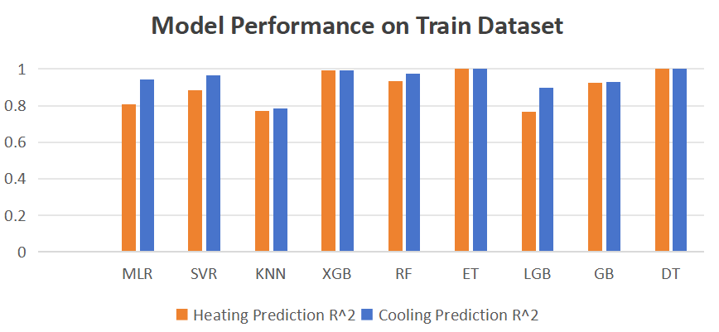
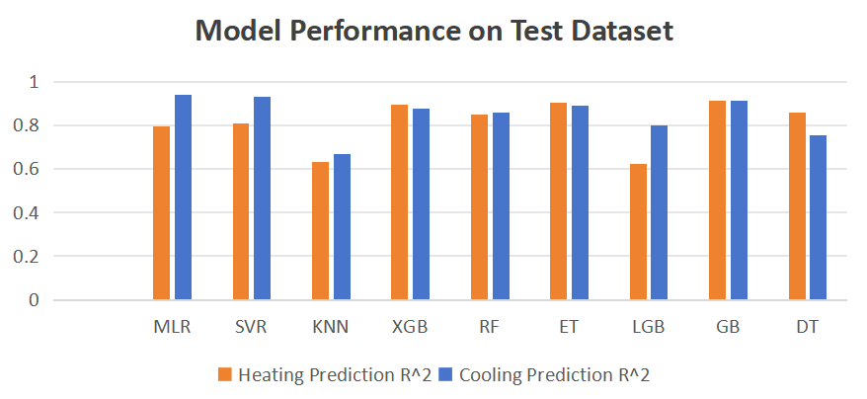
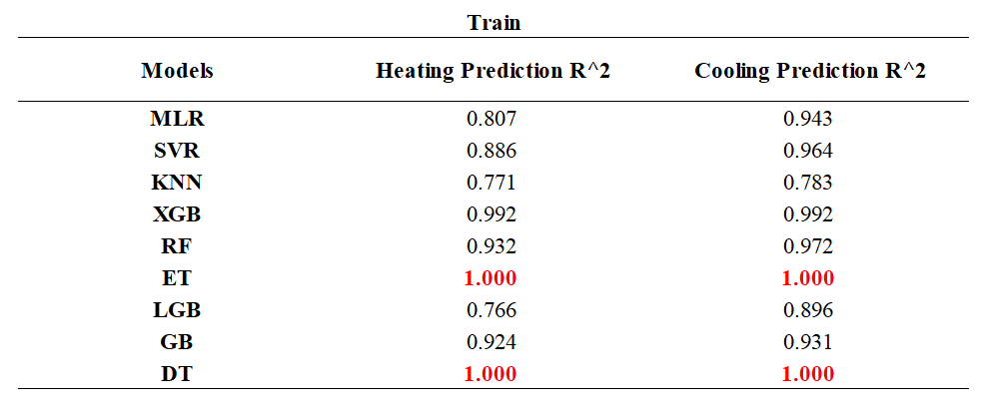
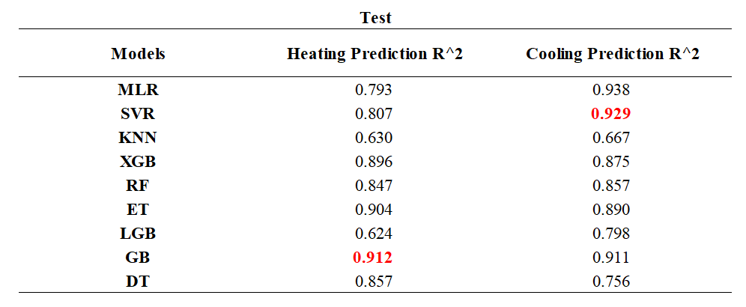
Our Solution
7
Updated datasets with 3 more features

Slide 12
Final Product - Tech Stack
9
Energy Predictor Game, Development Process
API Requests
Designed Building Footprints
Converted GB Model into SAV format
Previewer
Integrated Backend with frontend
Default Geometries
Notes:
Here we have both front end and back end tools we used for the predictor. On the left, we have elements that went into the back end and on the right we have our front end tools.
Starting from the left on the bottom, The backbone of our data is the Comstock Dataset. We used this dataset to set default values for different building types, making the tool more accessible for users by pre-filling essential data. We simplified parameters to make the interface more streamlined. One example of this simplification is how we combined window and wall areas into a single metric: the Window-to-Wall Ratio, or WWR. Instead of asking the user to input window and wall areas separately, we unified these into one.
"To connect our predictive model to the interface, we converted our GB model into SAV files using Scikit. We then used a python script to load the models and Flask to create a server that our frontend interface connects to. This setup allows user input to be fed into the model and also the model to display an output on the frontend.
___
"Now, let’s look at the frontend tools. We used Next.js to ensure smooth integration between the backend and frontend. This framework manages data flow so that simulation results are stored and retrieved efficiently."
"We wanted users to interact with simulation results visually, so we also imported 3D models from Blender and used Three.js to build an interactive geometry previewer. With this, users can view a 3D rendering of their building in real time."

Slide 13
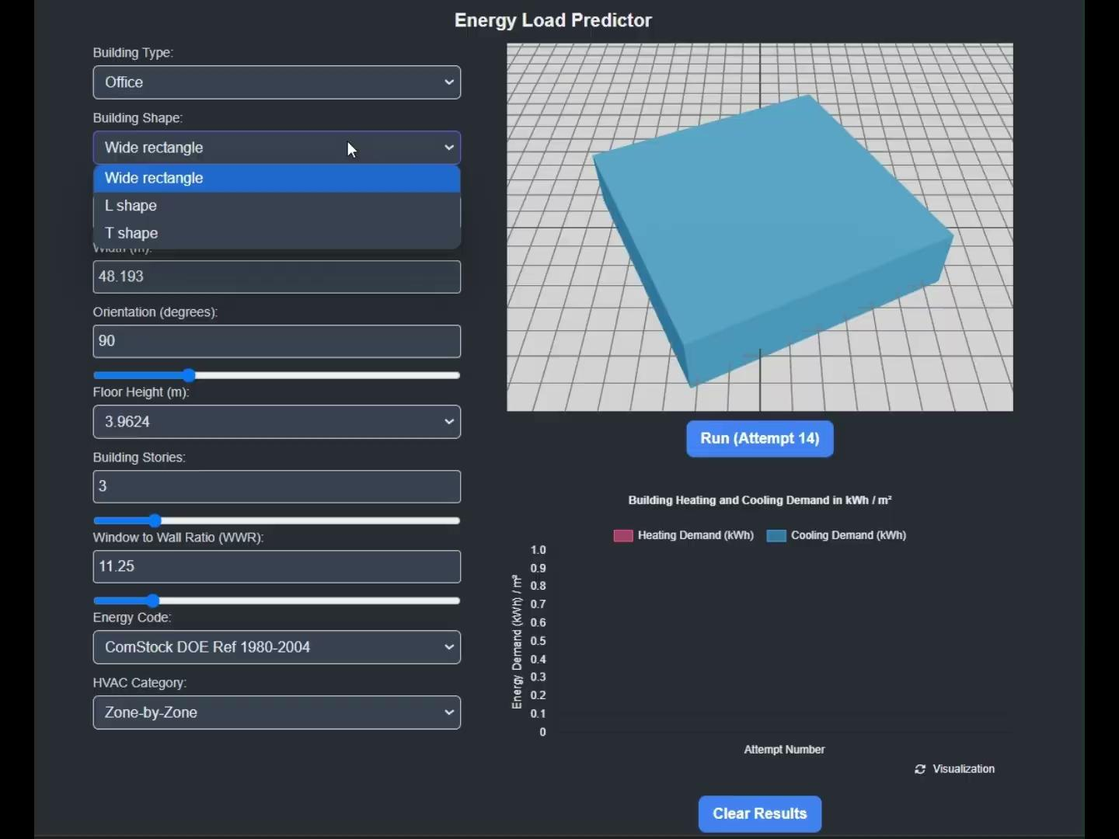
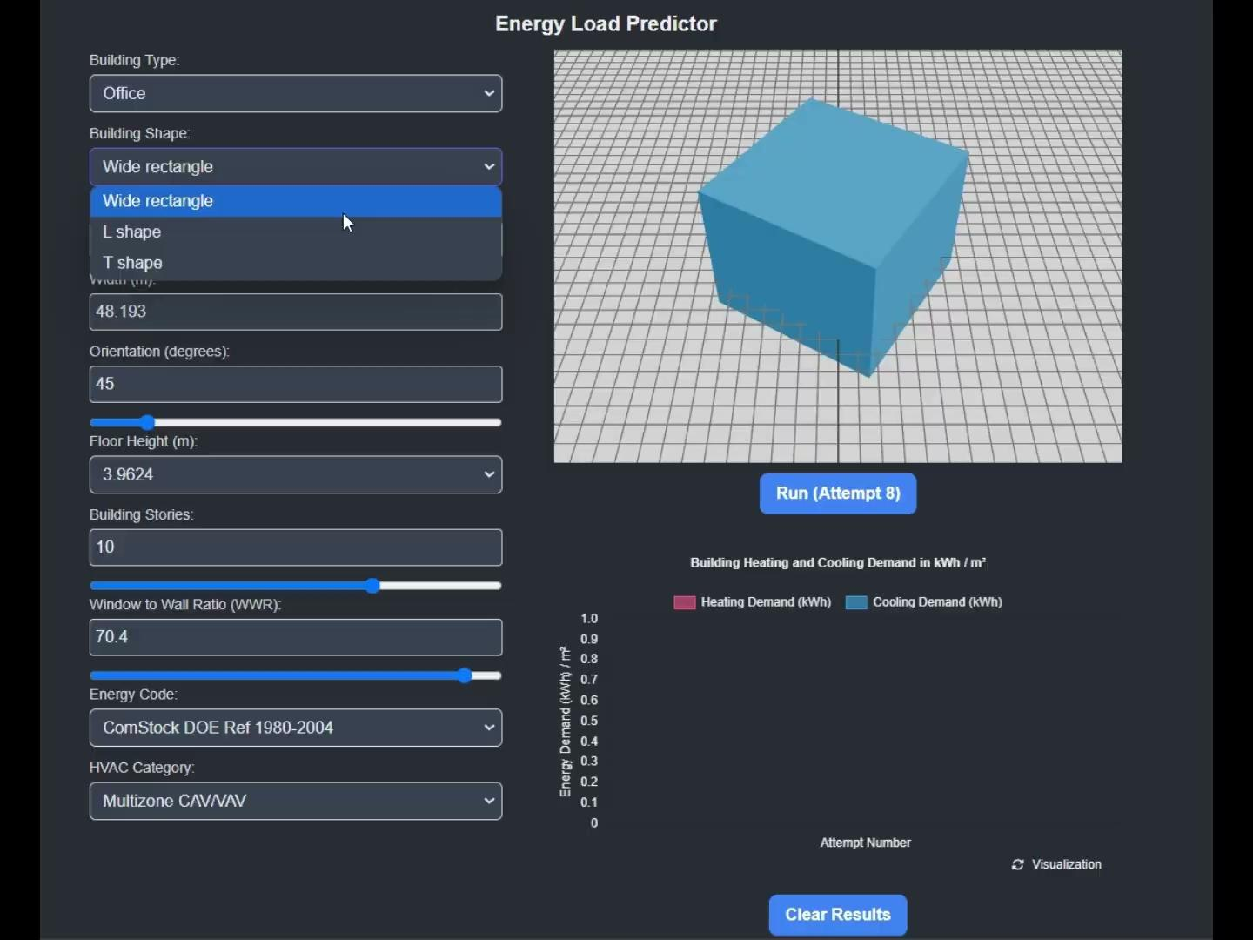
Experiments
10
Energy Predictor Game
Game Overview: Simulate the early building design phase, optimizing based on role priorities
Persona I (Architect):
Persona II (ESG Consultant):
Prioritize shape and form, height and WWR
Minimize energy demand
Notes:
We conducted experiments to assess how effectively this tool supports the evaluation of different design choices for reducing energy load.
Each player selects the same building type -- office. from there players are free to change any parameter to meet the goals of their specific roles. players had 5 attempts to refine the design.
The goal of the game is to simulate the early building design phase and optimize the project according to specific role-based priorities.
Architect. Let’s say I’m an architect. As an architect I’m more interested in the building’s shape, height, window to wall ratio. I go with a WWR of 30% because this allows for natural daylight to come in without creating excessive glare. This is important for occupant comfort and productivity– especially in an office setting.
ESG Consultant. On the other hand, let’s say im an ESG Consultant. As an ESG Consultant my main priority is to mininize energy consumption. Initial findings indicate that a narrow rectangle footprint could significantly increase both heating loads and cooling loads. To mitigate this, I shifted from a multizone CAV/VAV HVAC system to a smaller packaged unit and reduced the WWR.
Players assume one of three roles:
1) Real Estate Investor that Focuses on cost-effectiveness.
2) Architect that Prioritizes the building’s shape, form, height, and window-to-wall ratio (WWR).
3) ESG Consultant that Aims to minimize energy demand for a more sustainable design.

Slide 14
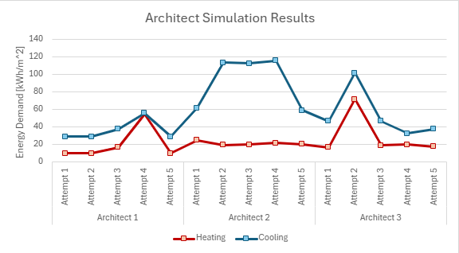
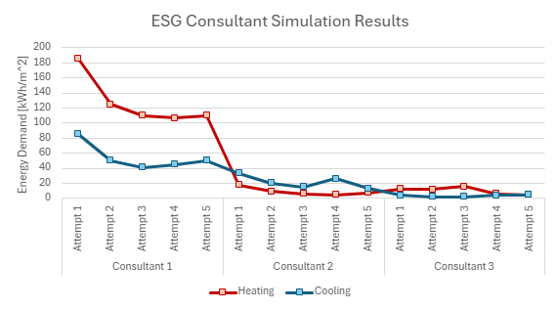
Experiments
11
Energy Predictor Game
Notes:
"Here we have the simulation results for six people playing the game, each working on the same building type. We can see the performance trends for both the Architect and ESG Consultant roles over five attempts."
"On the left, we have the results for three Architects. Each architect adjusted their design parameters over five attempts, primarily focusing on occupant comfort and aesthetics, including maintaining an optimal Window-to-Wall Ratio (WWR) for natural daylight."
"As you can see, there’s variability in both heating and cooling demands across their attempts, with some peaks indicating increased cooling loads for certain designs. However, by the final attempt, each architect achieved a balanced but moderate reduction in energy demand."
We see that the ESG consultant has the lowest energy consumption by the end of the 5 attempt, with the architects coming in second
Presenter: "On the right, we see the simulation results for the ESG Consultants. Their focus was on minimizing energy consumption by adjusting factors like WWR and HVAC system types."
"The ESG Consultants show a downward trend in energy demand across attempts. By the fifth attempt, they achieved the lowest energy consumption levels compared to the Architects, particularly with a significant reduction in heating loads. This reflects the ESG Consultants’ goal to optimize for sustainability and energy efficiency."

Slide 15
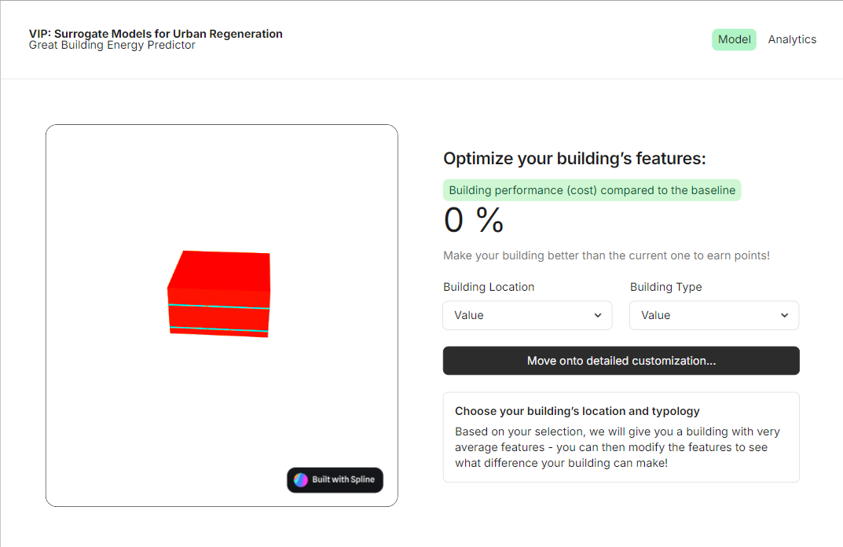
Conclusion & Way Forward
12
Target Audience, Future Applications of this game, features and ways to further optimize model
Target Market: Students, support pilot tests for ECM/EEM strategies, real-time energy consumption tracking
Future features: Model learning over time, suggest “best combination” scenarios, energy performance trends
UI enhancements: Sandbox experience to facilitate wider use in academic and industrial communities
Notes:
This tool was designed for primarily for students and early-stage projects, however this tool could also be used to potentially support pilot tests for Energy Conservation Measures or Energy Efficiency Measures strategies, with potential applications including real-time energy consumption tracking and the ability to compare variations between design choices across iterations.
Future features could include model learning over time to suggest optimal “best combination” scenarios, while global usage data aggregation could reveal energy performance trends, providing insights for academics and policymakers.
UI enhancements could focus on creating a more streamlined, sandbox experience to facilitate wider use in academic and industrial communities, promoting broader adoption and collaborative learning.

Slide 16
Team
13
Dr. Patrick Kastner
Anubha Mahajan
Jessica Hernandez
Jiayi Li
Shivam Patel
Hang Xu
Sharmista Debnath
Joseph Mathew Aerathu
Han-Syun Shih
Kiana-Karla Layam

Slide 17
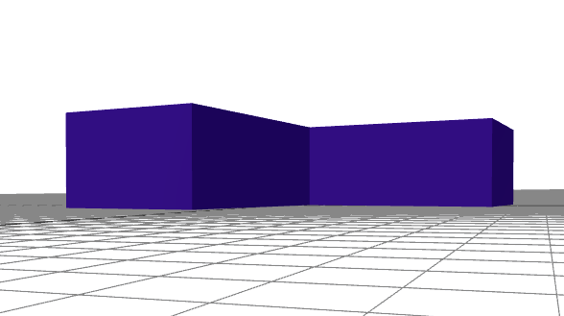
PRESENTATION
VIP-SMUR
VIP-SMUR
Energy Predictor
TEAM: Anubha Mahajan, Jessica Hernandez, Hang Xu, Joseph Mathew Aerathu, Jiayi Li, Han-Syun Shih, Kiana-Karla Layam, Sharmista Debnath, Shivam Patel (Guided by Prof. Patrick Kastner)

Slide 18
References
13
Reinhart, C. F., Dogan, T., Ibarra, D., & Samuelson, H. W. (2012). Learning by playing – teaching energy simulation as a game. Journal of Building Performance Simulation, 5(6), 359–368. https://doi.org/10.1080/19401493.2011.619668

Slide 19
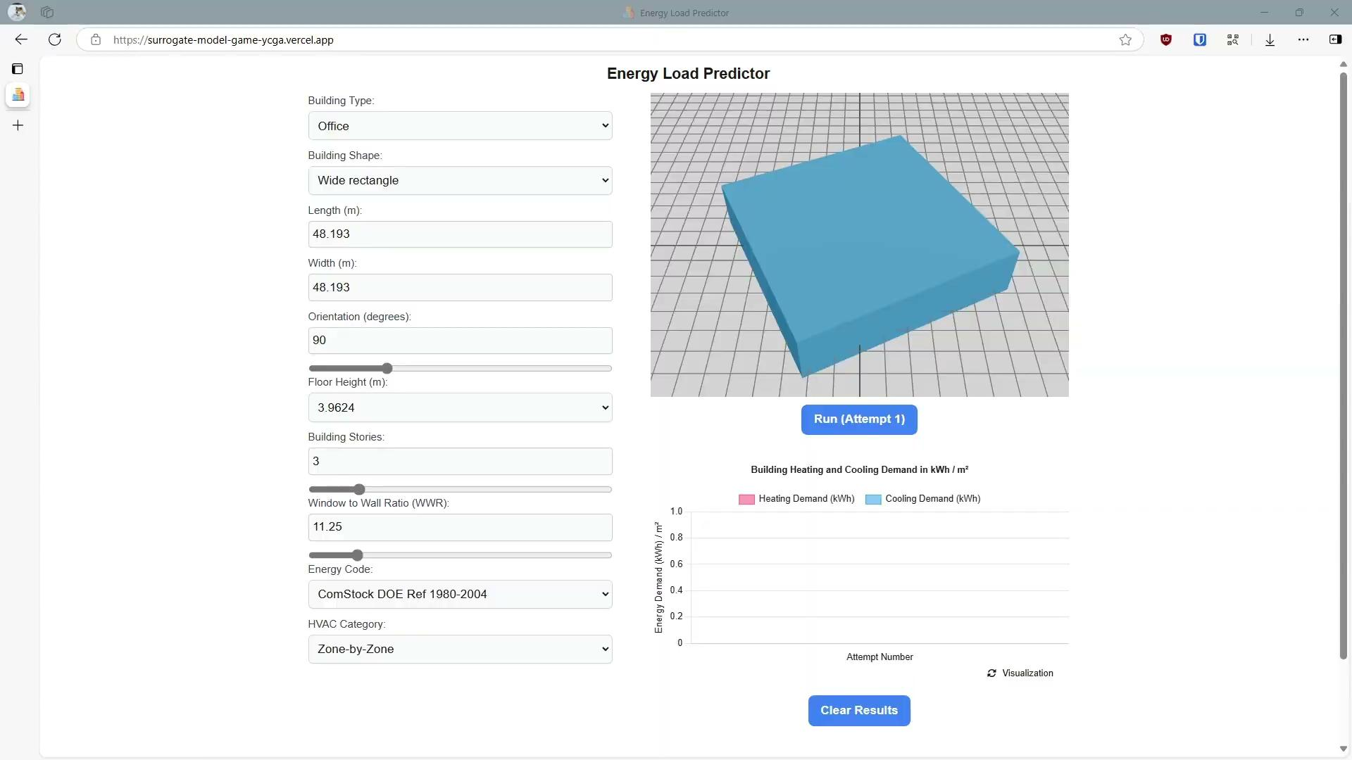
Final Product
10
Energy Predictor Game, Development Process
Notes:
https://youtu.be/1xp3xEn94QQ

Slide 20
Experiments
9
Energy Predictor Game
Game Overview: Simulate the early building design phase, optimizing based on role priorities
Roles and Objectives:
Real Estate Investor: Focus on cost-effectiveness
Architect: Prioritize shape and form, height and WWR
ESG Consultant: Minimize energy demand
Game Rules:
Select Building Type: Start with Office typology
Adjust Parameters: Customize to meet your roles’ goal. You have five attempts, so choose carefully!
Run Simulation: Click "Run" and "Visualize" for heating/cooling loads
Compare Results: Screenshot your final graph to compare designs

Slide 21
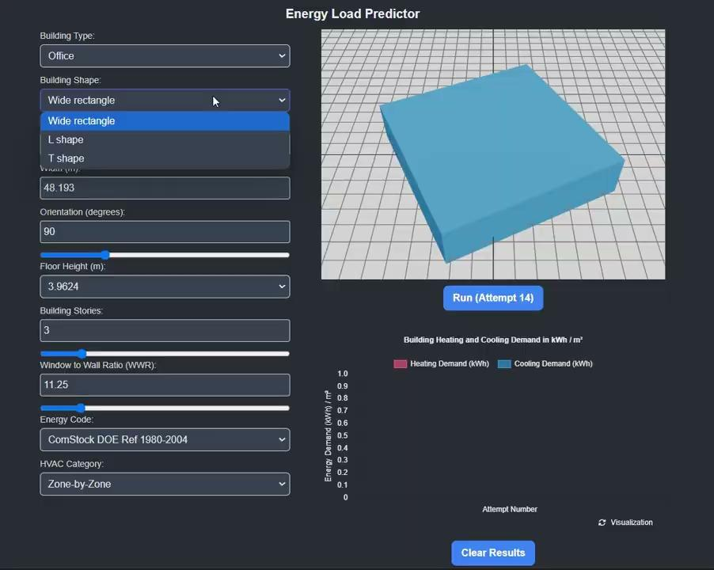
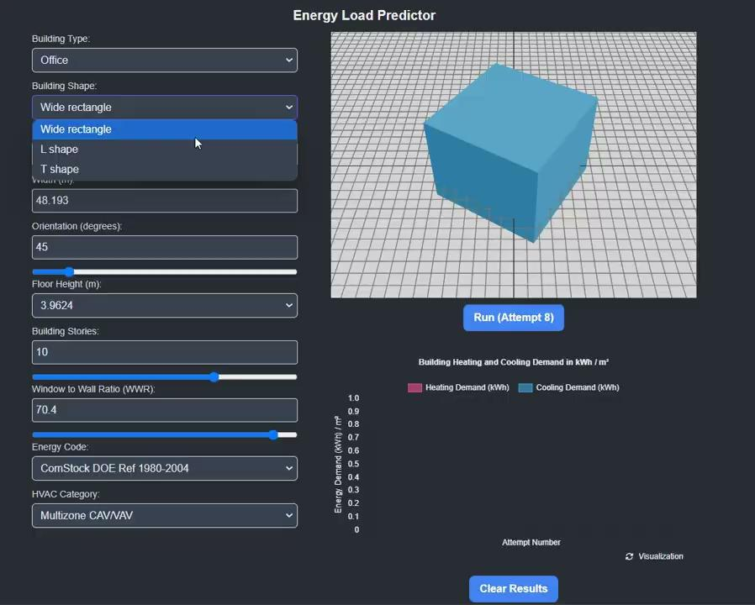
Game Demo
9
Energy Predictor Game, Development Process
Persona I (Architect):
Persona II (ESG Consultant):
Notes:
Take on a persona and talk about the experiments

Slide 22
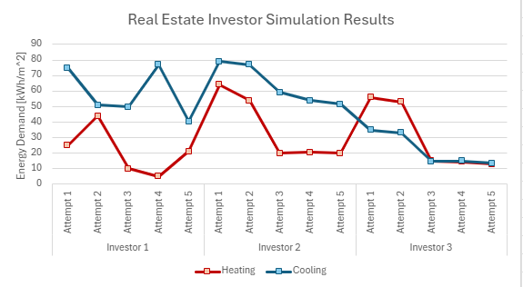
Experiments
11
Energy Predictor Game

